Slide 1
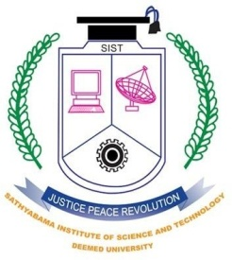

SCSA1301-DBMS
SATHYABAMA
INSTITUTE OF SCIENCE AND TECHNOLOGY
UNIT-V
Dr.L.LAKSHMANAN
DEPARTMENT OF COMPUTER SCIENCE AND ENGINEERING
DBMS-UNIT-V

Slide 2
CONCEPTS OF OBJECT DATABASES
1 Overview of O-O Concepts
2 O-O Identity, Object Structure and Type Constructors
3 Encapsulation of Operations, Methods and Persistence
4 Type and Class Hierarchies and Inheritance
5 Complex Objects
6 Other O-O Concepts
7 OODBMS
DBMS-UNIT-V

Slide 3
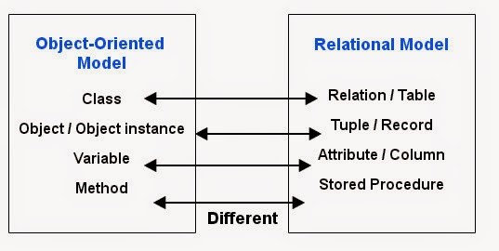
Object Oriented (OO) Data Models since mid-90’s
Reasons for creation of Object Oriented Databases
  Need for more complex applications
  Need for additional data modeling features
  Increased use of object-oriented programming languages
Commercial OO Database products –
  Several in the 1990’s, but did not make much impact on main stream data management
DBMS-UNIT-V

Slide 4
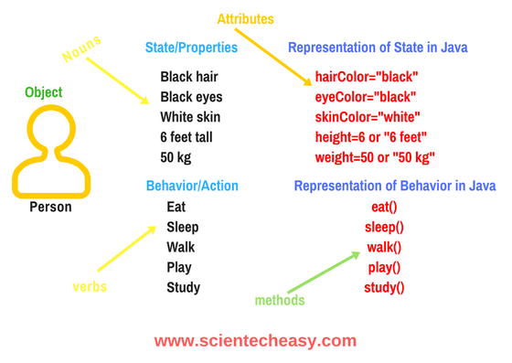

Definition of an object
Objects – User defined complex data types
An object has structure or state (variables) and methods (behavior/operations)
An object is described by four characteristics
Identifier: a system-wide unique id for an object
Name: an object may also have a unique name in DB (optional)
Lifetime: determines if the object is persistent or transient
Structure: Construction of objects using type constructors
DBMS-UNIT-V

Slide 5
Object Identity
Unique Identity:
  An OO database system provides a unique identity to each independent object stored in the database.
    This unique identity is typically implemented via a unique, system-generated object identifier, or OID
The main property required of an OID is that it be immutable
  Specifically, the OID value of a particular object should not change.
  This preserves the identity of the real-world object being represented.
DBMS-UNIT-V

Slide 6
Object Structure and Type Constructors
The state (current value) of a complex object may be constructed from other objects (or other values) by using certain type constructors
Can be represented by (i,c,v)
  i is an unique id
  c is a type constructor
  v is the object state
Type Constructors:
  In OO databases, the state (current value) of a complex object may be constructed from other objects (or other values) by using certain type constructors.
  Basic types: atom, tuple and set
  Collection type: list, bag and array
DBMS-UNIT-V

Slide 7
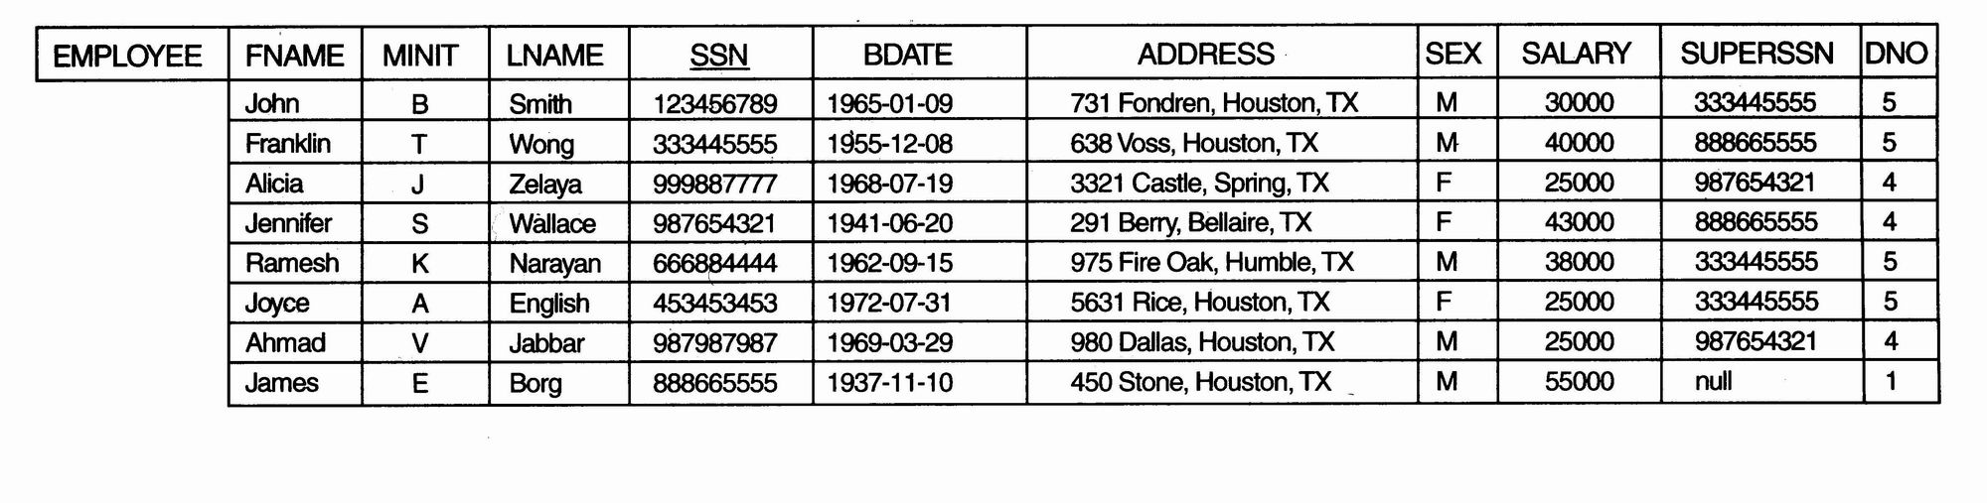
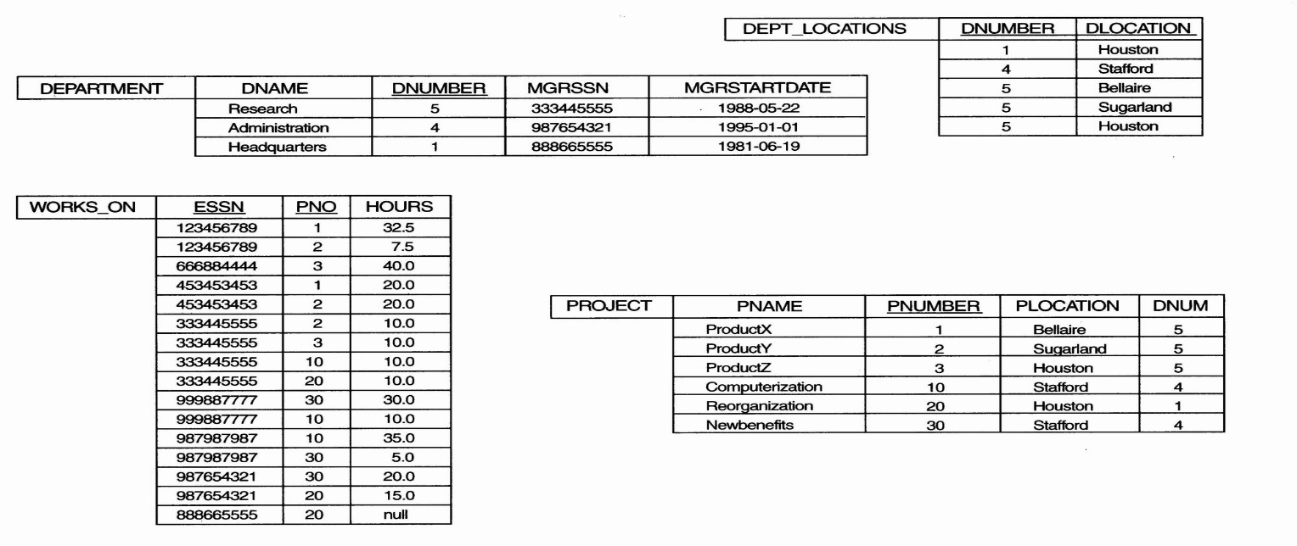
Example
  One possible relational database state corresponding to COMPANY schema
DBMS-UNIT-V

Slide 8
Example
  We use i₁, i₂, i₃, . . . to stand for unique system-generated object identifiers. Consider the following objects:
    o₁ = (i₁, atom, ‘Houston’)
    o₂ = (i₂, atom, ‘Bellaire’)
    o₃ = (i₃, atom, ‘Sugarland’)
    o₄ = (i₄, atom, 5)
    o₅ = (i₅, atom, ‘Research’)
    o₆ = (i₆, atom, ‘1988-05-22’)
    o₇ = (i₇, set, {i1, i2, i3})
    o₈ = (i₈, tuple, <dname:i₅, dnumber:i₄, mgr:i₉, locations:i₇, employees:i₁₀, projects:i₁₁>)
    o₉ = (i₉, tuple, <manager:i₁2, manager_start_date:i₆>)
    o₁₀ = (i₁₀, set, {i₁₂, i₁₃, i₁₄})
    o₁₁ = (i₁₁, set {i₁₅, i₁₆, i₁₇})
    o₁₂ = (i₁₂, tuple, <fname:i₁₈, minit:i₁₉, lname:i₂₀, ssn:i₂₁, . . ., salary:i₂₆, supervi­sor:i₂₇, dept:i₈>)
  The first six objects listed in this example represent atomic values.
  Object seven is a set-valued object that represents the set of locations for department 5; the set refers to the atomic objects with values {‘Houston’, ‘Bellaire’, ‘Sugarland’}.
  Object 8 is a tuple-valued object that represents department 5 itself, and has the attributes DNAME, DNUMBER, MGR, LOCATIONS, and so on.
DBMS-UNIT-V

Slide 9
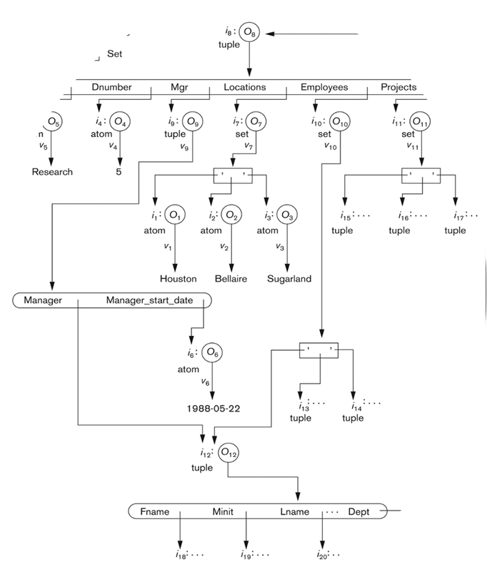
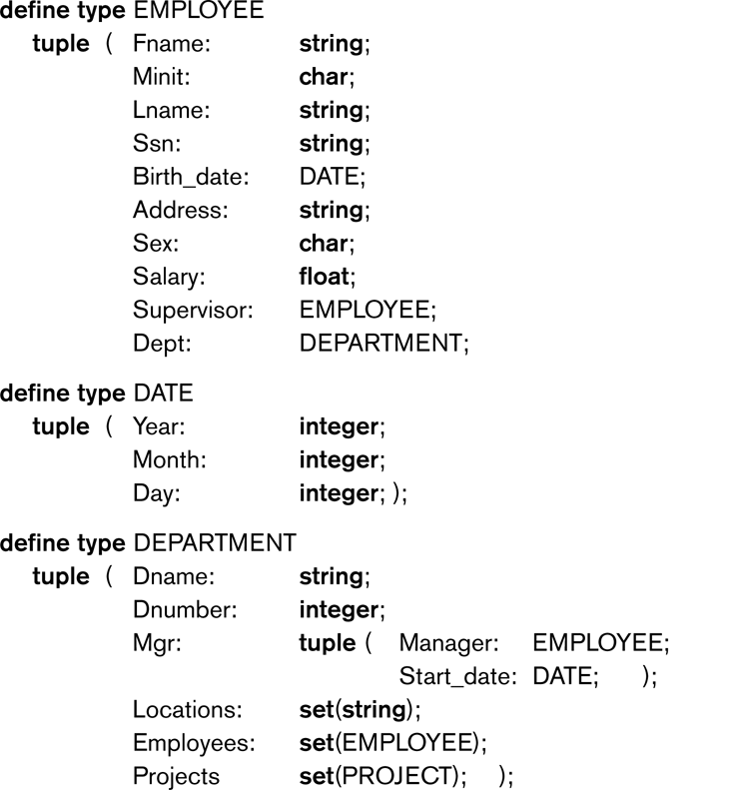
Object Diagram and Type Constructor
DBMS-UNIT-V

Slide 10
Object-Oriented Concepts
Abstract Data Types
  Class definition, provides extension to complex attribute types
Encapsulation
  Implementation of operations and object structure hidden
Inheritance
  Sharing of data within hierarchy scope, supports code reusability
Polymorphism
  Operator overloading
DBMS-UNIT-V

Slide 11
Encapsulation of Operations, Methods, and Persistence
Specifying Object Behavior via Class Operations:
  The main idea is to define the behavior of a type of object based on the operations that can be externally applied to objects of that type.
  In general, the implementation of an operation can be specified in a general-purpose programming language that provides flexibility and power in defining the operations.
  For database applications, the requirement that all objects be completely encapsulated is too stringent.
DBMS-UNIT-V

Slide 12
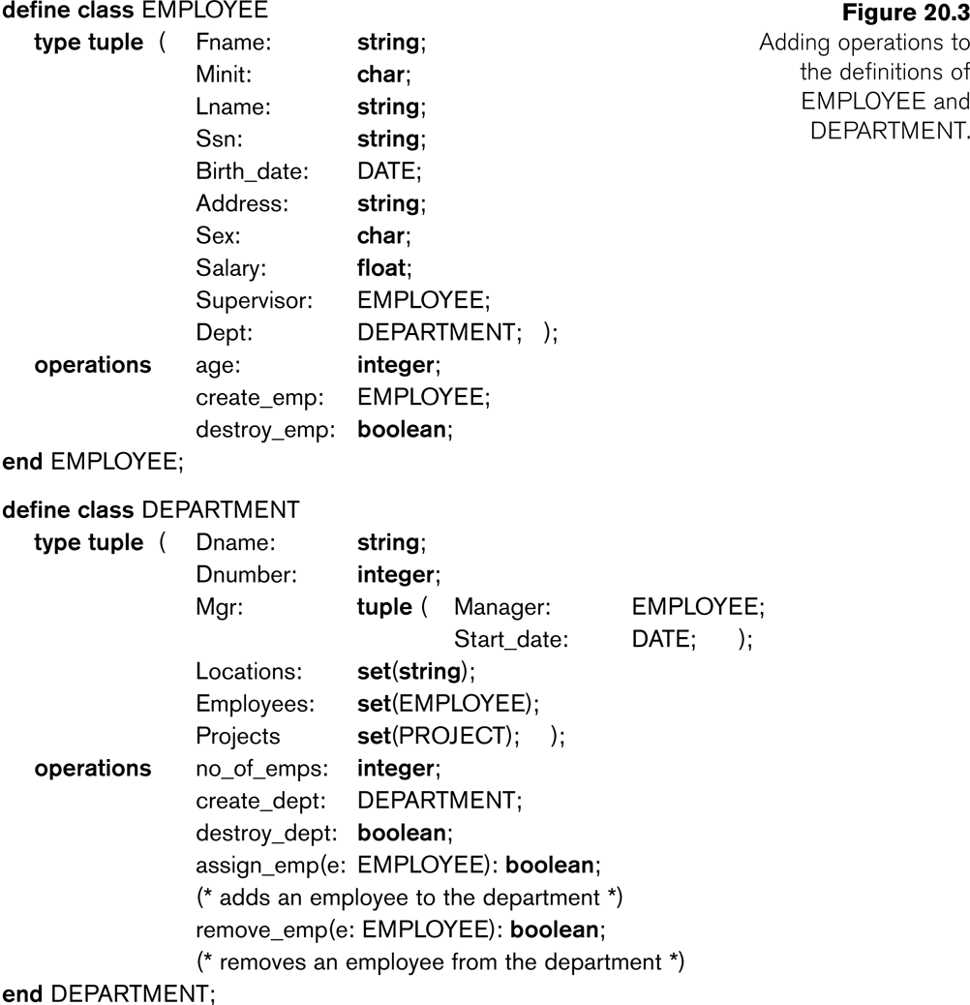
DBMS-UNIT-V

Slide 13
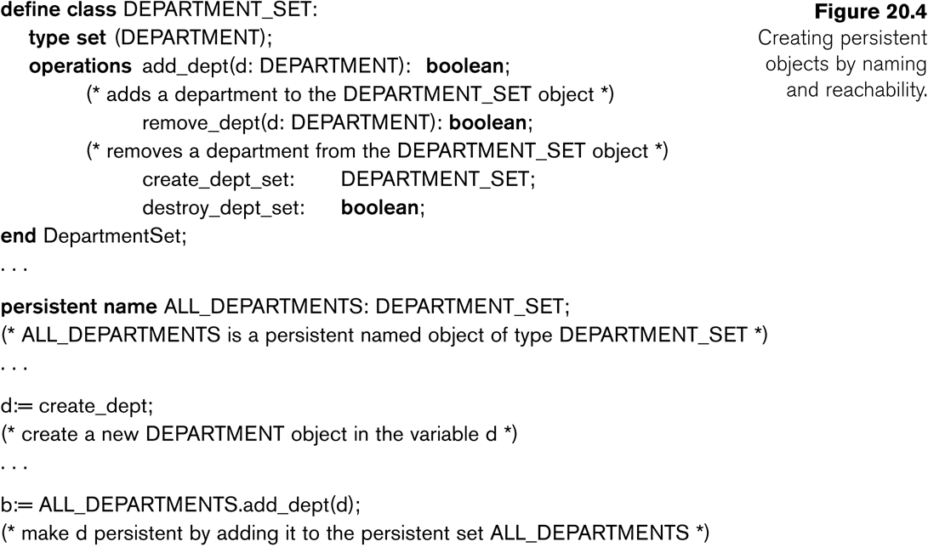
Specifying Object Persistence via Naming and Reachability:
  Naming Mechanism:
    Assign an object a unique persistent name through which it can be retrieved by this and other programs.
  Reachability Mechanism:
    Make the object reachable from some persistent object.
    An object B is said to be reachable from an object A if a sequence of references in the object graph lead from object A to object B.
DBMS-UNIT-V

Slide 14
Type and Class Hierarchies and Inheritance
Type (class) Hierarchy
  A type in its simplest form can be defined by giving it a type name and then listing the names of its visible (public) functions
  When specifying a type in this section, we use the following format, which does not specify arguments of functions, to simplify the discussion:
    TYPE_NAME: function, function, . . . , function
  Example:
    PERSON: Name, Address, Birthdate, Age, SSN
Subtype:
  When the designer or user must create a new type that is similar but not identical to an already defined type
Supertype:
  It inherits all the functions of the subtype
DBMS-UNIT-V

Slide 15
Example (1):
  PERSON: Name, Address, Birthdate, Age, P-ID
  EMPLOYEE: Name, Address, Birthdate, Age, P-ID, Salary, HireDate, Seniority
  STUDENT: Name, Address, Birthdate, Age, P-ID, Major, GPA
OR:
  EMPLOYEE subtype-of PERSON: Salary, HireDate, Seniority
  STUDENT subtype-of PERSON: Major, GPA
DBMS-UNIT-V

Slide 16
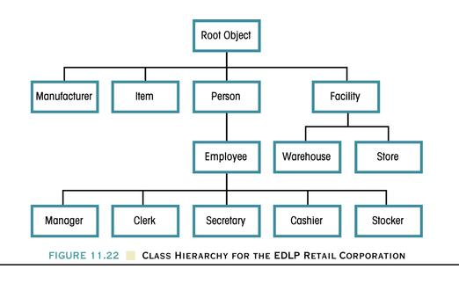
Class Hierarchy For The EDLP Retail Corporation
DBMS-UNIT-V

Slide 17
Type and Class Hierarchies and Inheritance
Extents:
  In most OO databases, the collection of objects in an extent has the same type or class.
  However, since the majority of OO databases support types, we assume that extents are collections of objects of the same type for the remainder of this section.
Persistent Collection:
  This holds a collection of objects that is stored permanently in the database and hence can be accessed and shared by multiple programs
Transient Collection:
  This exists temporarily during the execution of a program but is not kept when the program terminates
DBMS-UNIT-V

Slide 18
Other Objected-Oriented Concepts
Polymorphism (Operator Overloading):
  This concept allows the same operator name or symbol to be bound to two or more different implementations of the operator, depending on the type of objects to which the operator is applied
  For example + can be:
    Addition in integers
    Concatenation in strings (of characters)
DBMS-UNIT-V

Slide 19
Complex Objects
Unstructured complex object:
  These is provided by a DBMS and permits the storage and retrieval of large objects that are needed by the database application.
Typical examples of such objects are bitmap images and long text strings (such as documents); they are also known as binary large objects, or BLOBs for short.
This has been the standard way by which Relational DBMSs have dealt with supporting complex objects, leaving the operations on those objects outside the RDBMS.
DBMS-UNIT-V

Slide 20
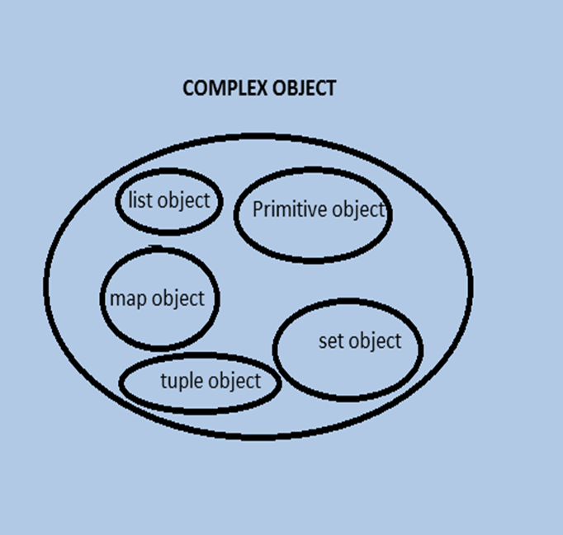
Complex Objects
Structured complex object:
  This differs from an unstructured complex object in that the object’s structure is defined by repeated application of the type constructors provided by the OODBMS.
  Hence, the object structure is defined and known to the OODBMS.
  The OODBMS also defines methods or operations on it.
DBMS-UNIT-V

Slide 21
What is Object Oriented Database? (OODB)
A database system that incorporates all the important object-oriented concepts
Some additional features
  Unique Object identifiers
  Persistent object handling
DBMS-UNIT-V

Slide 22
Advantages of OODBS
Designer can specify the structure of objects and their behavior (methods)
Better interaction with object-oriented languages such as Java and C++
Definition of complex and user-defined types
Encapsulation of operations and user-defined methods
DBMS-UNIT-V

Slide 23
Disadvantages of OODBS
  Lack of theoretical foundation.
  Lack of standard ad hoc query language.
  Lack of business data design and management tools.
  Lack of resources.
DBMS-UNIT-V

Slide 24
Object Query Language (OQL)
Declarative query language
  Not computationally complete
Syntax based on SQL (select, from, where)
Additional flexibility (queries with user defined operators and types)
The following is a sample query
“what are the names of the black product?”
Select distinct p.name
From products p
Where p.color = “black”
  Valid in both SQL and OQL, but results are different.
DBMS-UNIT-V

Slide 25
Result of the query
Product no | Name | Color
P1 | Ford Mustang | Black
P2 | Toyota Celica | Green
P3 | Mercedes SLK | Black
Original table
Result-SQL
Name
Ford Mustang Mercedes SLK
- The statement queries a relational database.
=> Returns a table with rows.
Result-OQL
String
Ford Mustang
String
Mercedes SLK
- The statement queries a object-oriented database
=> Returns a collection of objects.
DBMS-UNIT-V

Slide 26
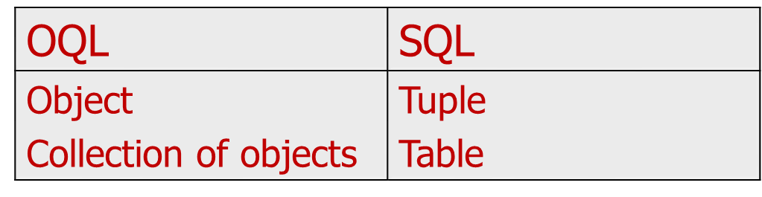
Comparison
Queries look very similar in SQL and OQL, sometimes they are the same
In fact, the results they give are very different
Query returns:
DBMS-UNIT-V

Slide 27
SQL3 “Object-oriented SQL”
Foundation for several OO database management systems – ORACLE8, DB2, etc
New features – “relational” & “Object oriented”
Relational Features – new data types, new predicates, enhanced semantics, additional security and an active database
Object Oriented Features – support for functions and procedures
DBMS-UNIT-V

Slide 28
Emerging Database Technologies and Application
1 Mobile Databases
2 Multimedia Databases
3 Geographic Information Systems
4 GENOME Data Management
DBMS-UNIT-V

Slide 29
Mobile Databases
Recent advances in portable and wireless technology led to mobile computing, a new dimension in data communication and processing.
Portable computing devices coupled with wireless communications allow clients to access data from virtually anywhere and at any time.
There are a number of hardware and software problems that must be resolved before the capabilities of mobile computing can be fully utilized.
Some of the software problems – which may involve data management, transaction management, and database recovery – have their origins in distributed database systems.
DBMS-UNIT-V

Slide 30
Mobile Databases
In mobile computing, the problems are more difficult, mainly:
  The limited and intermittent connectivity afforded by wireless communications.
  The limited life of the power supply(battery).
  The changing topology of the network.
  In addition, mobile computing introduces new architectural possibilities and challenges.
DBMS-UNIT-V

Slide 31

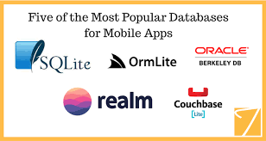
DBMS-UNIT-V

Slide 32
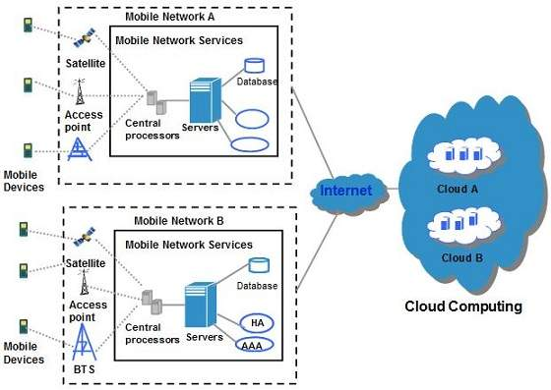
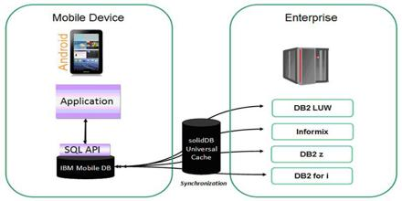
Mobile Computing Architecture
DBMS-UNIT-V

Slide 33
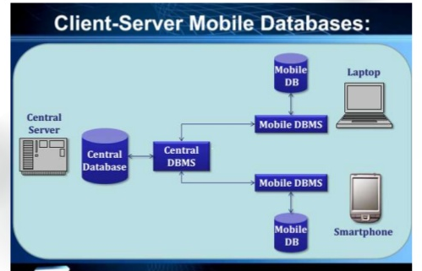
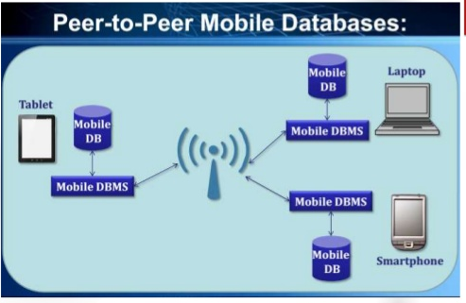
Mobile Database Architecture-types
DBMS-UNIT-V

Slide 34
Data Management Issues
From a data management standpoint, mobile computing may be considered a variation of distributed computing. Mobile databases can be distributed under two possible scenarios:
  The entire database is distributed mainly among the wired components, possibly with full or partial replication.
    A base station or fixed host manages its own database with a DBMS-like functionality, with additional functionality for locating mobile units and additional query and transaction management features to meet the requirements of mobile environments.
  The database is distributed among wired and wireless components.
    Data management responsibility is shared among base stations or fixed hosts and mobile units.
DBMS-UNIT-V

Slide 35
Data Management Issues
Data management issues as it is applied to mobile databases:
  Data distribution and replication
  Transactions models
  Query processing
  Recovery and fault tolerance
  Mobile database design
  Location-based service
  Division of labor
  Security
DBMS-UNIT-V

Slide 36
Application-Mobile Database
Whenever clients connect – through a process known in industry as synchronization of a client with a server – they receive a batch of updates to be installed on their local database.
  The primary characteristic of this scenario is that the clients are mostly disconnected; the server is not necessarily able reach them.
  This environment has problems similar to those in distributed and client-server databases, and some from mobile databases.
This environment is referred to as Intermittently Synchronized Database Environment (ISDBE).
Intermittently Synchronized Databases (ISDBs)
A client connects to the server when it wants to exchange updates.
A server cannot connect to a client at will.
DBMS-UNIT-V

Slide 37
Multimedia Databases
DBMSs have been constantly adding to the types of data they support.
Today many types of multimedia data are available in current systems.
  Text: May be formatted or unformatted. For ease of parsing structured documents, standards like SGML and variations such as HTML
  Graphics: Examples include drawings and illustrations that are encoded using some descriptive standards (e.g. CGM, PICT, postscript).
  Images: Includes drawings, photographs, and so forth, encoded in standard formats such as bitmap, JPEG, and MPEG. Compression is built into JPEG and MPEG.
  Animations: Temporal sequences of image or graphic data.
  Video: A set of temporally sequenced photographic data for presentation at specified rates– for example, 30 frames per second.
  Structured audio: A sequence of audio components comprising note, tone, duration, and so forth.
  Audio: Sample data generated from aural recordings in a string of bits in digitized form. Analog recordings are typically converted into digital form before storage.
DBMS-UNIT-V

Slide 38
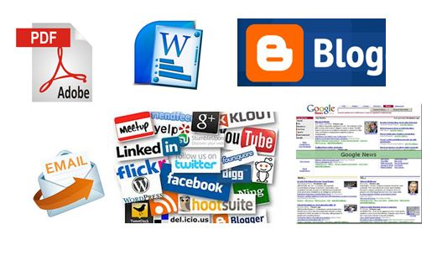
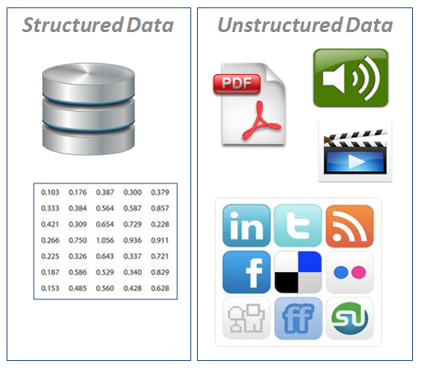
DBMS-UNIT-V

Slide 39
Multimedia Databases
Applications based on their data management characteristics:
  Repository applications: A large amount of multimedia data as well as metadata is stored for retrieval purposes. Examples include repositories of satellite images, engineering drawings and designs, space photographs, and radiology scanned pictures.
  Presentation applications: A large amount of applications involve delivery of multimedia data subject to temporal constraints; simple multimedia viewing of video data, for example, requires a system to simulate VCR-like functionality.
  Collaborative work using multimedia information: This is a new category of applications in which engineers may execute a complex design task by merging drawings, fitting subjects to design constraints, and generating new documentation, change notifications, and so forth. Intelligent healthcare networks as well as telemedicine will involve doctors collaborating among themselves, analyzing multimedia patient data and information in real time as it is generated.
DBMS-UNIT-V

Slide 40
Data Management Issues
Multimedia information systems are very complex and embrace a large set of issues:
  Modeling
    Complex objects
  Design
    Conceptual, logical, and physical design of multimedia has not been addressed fully.
  Storage
    Multimedia data on standard disklike devices presents problems of representation, compression, mapping to device hierarchies, archiving, and buffering during the input/output operation.
  Queries and retrieval
    “Database” way of retrieving information is based on query languages and internal index structures.
  Performance
    Multimedia applications involving only documents and text, performance constraints are subjectively determined by the user.
DBMS-UNIT-V

Slide 41
Multimedia Database Applications
Large-scale applications of multimedia databases can be expected encompasses a large number of disciplines and enhance existing capabilities.
  Documents and records management
  Knowledge dissemination
  Education and training
  Marketing, advertising, retailing, entertainment, and travel
  Real-time control and monitoring
DBMS-UNIT-V

Slide 42
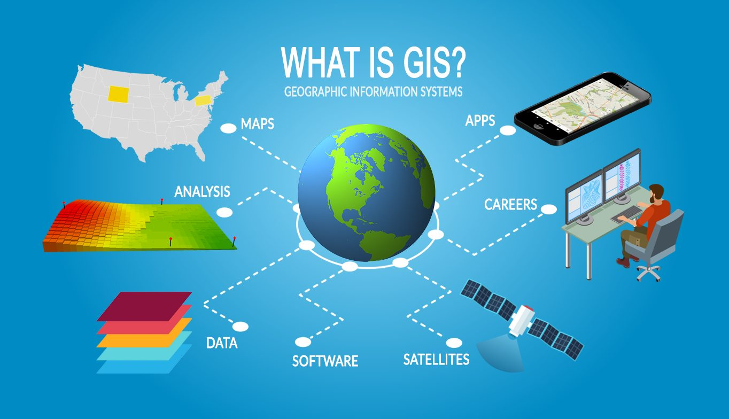
Geographic Information Systems
Geographic information systems(GIS) are used to collect, model, and analyze information describing physical properties of the geographical world.
DBMS-UNIT-V

Slide 43
Geographic Information Systems
The scope of GIS broadly encompasses two types of data:
  Spatial data, originating from maps, digital images, administrative and political boundaries, roads, transportation networks, physical data, such as rivers, soil characteristics, climatic regions, land elevations, and
  Non-spatial data, such as socio-economic data (like census counts), economic data, and sales or marketing information. GIS is a rapidly developing domain that offers highly innovative approaches to meet some challenging technical demands.
DBMS-UNIT-V

Slide 44
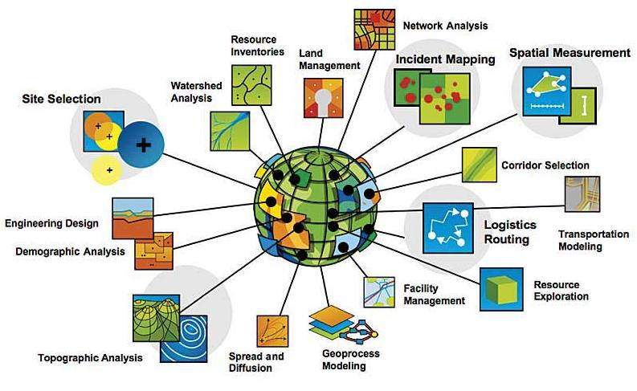
GIS Applications
DBMS-UNIT-V

Slide 45
Data Management Requirements of GIS
Data Analysis
GIS data undergoes various types of analysis.
  For example, in applications
    such as soil erosion studies, environmental impact studies, or hydrological runoff simulations,
  DTM data may undergo various types of geomorphometric analysis – measurements such as
    slope values, gradients (the rate of change in altitude), aspect (the compass direction of the gradient), profile convexity (the rate of change of gradient), plan convexity (the convexity of contours and other parameters).
DBMS-UNIT-V

Slide 46
Data Management Requirements of GIS
Data Integration
GISs must integrate both vector and raster data from a variety of sources.
  Sometimes edges and regions are inferred from a raster image to form a vector model, or conversely, raster images such as aerial photographs are used to update vector models.
  Several coordinate systems such as Universal Transverse Mercator (UTM), latitude/longitude, and local cadastral systems are used to identify locations.
  Data originating from different coordinate systems requires appropriate transformations.
DBMS-UNIT-V

Slide 47
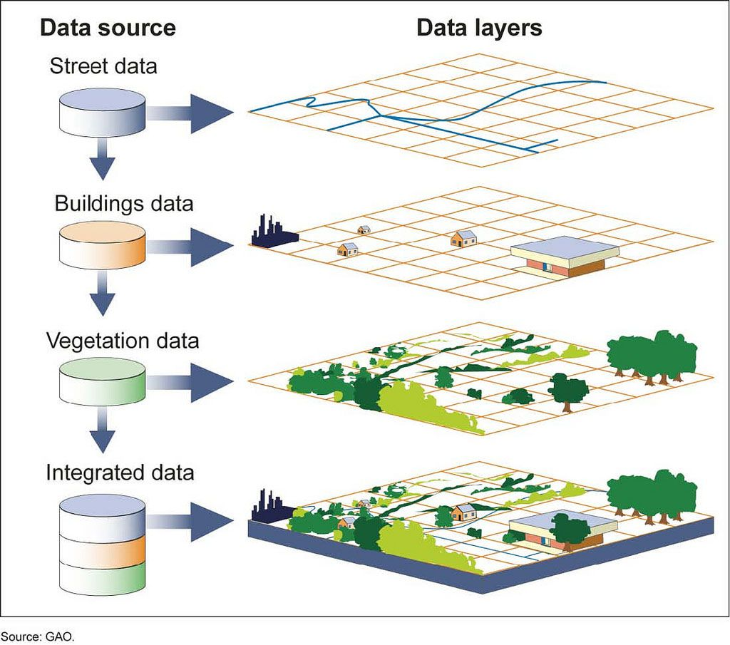
DBMS-UNIT-V

Slide 48
Data Management Requirements of GIS
Data Capture
The first step in developing a spatial database for cartographic modeling is
  to capture the two-dimensional or three-dimensional geographical information in digital form
    This process that is sometimes impeded by source map characteristics such as resolution, type of projection, map scales, cartographic licensing, diversity of measurement techniques, and coordinate system differences.
  Spatial data can also be captured from remote sensors in satellites such as Landsat, NORA, and Advanced Very High Resolution Radiometer(AVHRR) as well as SPOT HRV (High Resolution Visible Range Instrument.
DBMS-UNIT-V

Slide 49
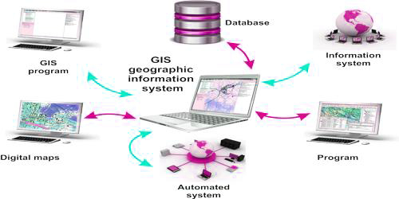
DBMS-UNIT-V

Slide 50
Specific GIS Data Operations
The functionality of a GIS database is also subject to other considerations:
  Extensibility
  Data quality control
  Visualization
Such requirements clearly illustrate that standard RDBMSs or ODBMSs do not meet the special needs of GIS.
  Therefore it is necessary to design systems that support the vector and raster representations and the spatial functionality as well as the required DBMS features.
  Vector data represents geometric objects such as points, lines, and polygons.
  Raster data is characterized as an array of points, where each point represents the value of an attribute for a real-world location.
DBMS-UNIT-V

Slide 51
Genome Data Management
Biological Sciences and Genetics:
  The biological sciences encompass an enormous variety of information.
    Environmental science gives us a view of how species live and interact in a world filled with natural phenomena.
    Biology and ecology study particular species.
    Anatomy focuses on the overall structure of an organism, documenting the physical aspects of individual bodies.
    Traditional medicine and physiology break the organism into systems and tissues and strive to collect information on the workings of these systems and the organism as a whole.
DBMS-UNIT-V

Slide 52
The Genome Database (GDB)
More recently efforts have been made to add data on mutations linked to genetic loci, cell lines used in experiments, DNA probe libraries, and some limited polymorphism and population data.
  The GDB system is built around Sybase, a commercial relational DBMS, and its data are modeled using standard Entity-Relationship techniques.
    GDB distributes a Database Access Toolkit
DBMS-UNIT-V

Slide 53
The Genome Database (GDB)
As with GenBank, users are given only a very high-level view of the data at the time of searching and thus cannot make use of any knowledge gleaned from the structure of the GDB tables.
    Search methods are most useful when users are simply looking for an index into map or probe data.
    Exploratory ad hoc searching is not encouraged by present interfaces.
DBMS-UNIT-V

Slide 54
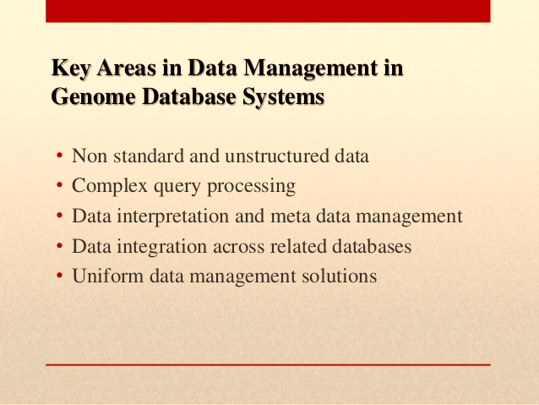
DBMS-UNIT-V

Slide 55
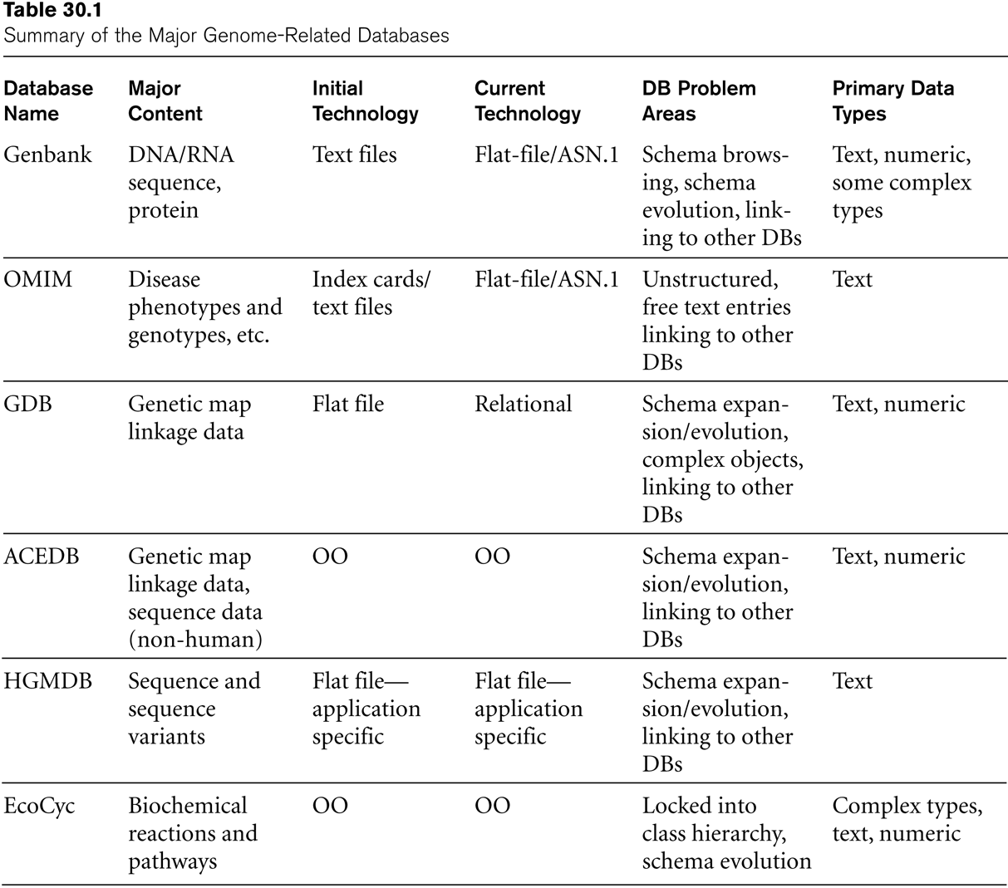
Major Genome-Related Databases
DBMS-UNIT-V

Slide 56
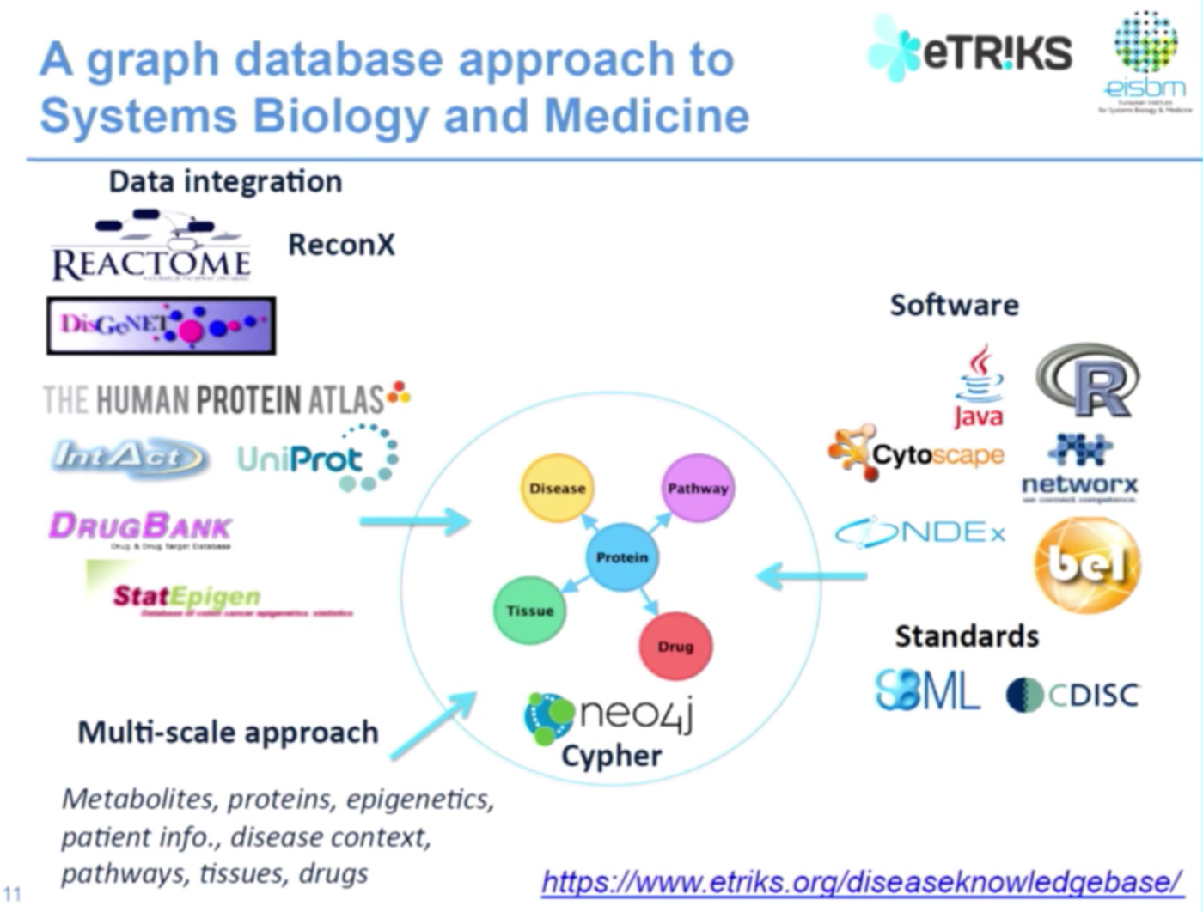
DBMS-UNIT-V

Slide 57
THANK YOU
ANY QUERIES ?
Dr.L.LAKSHAMAN
Lakshmanan.cse@sathyabama.ac.in
DBMS-UNIT-V

